Slide 1

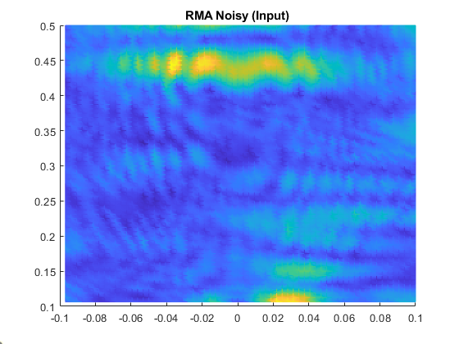

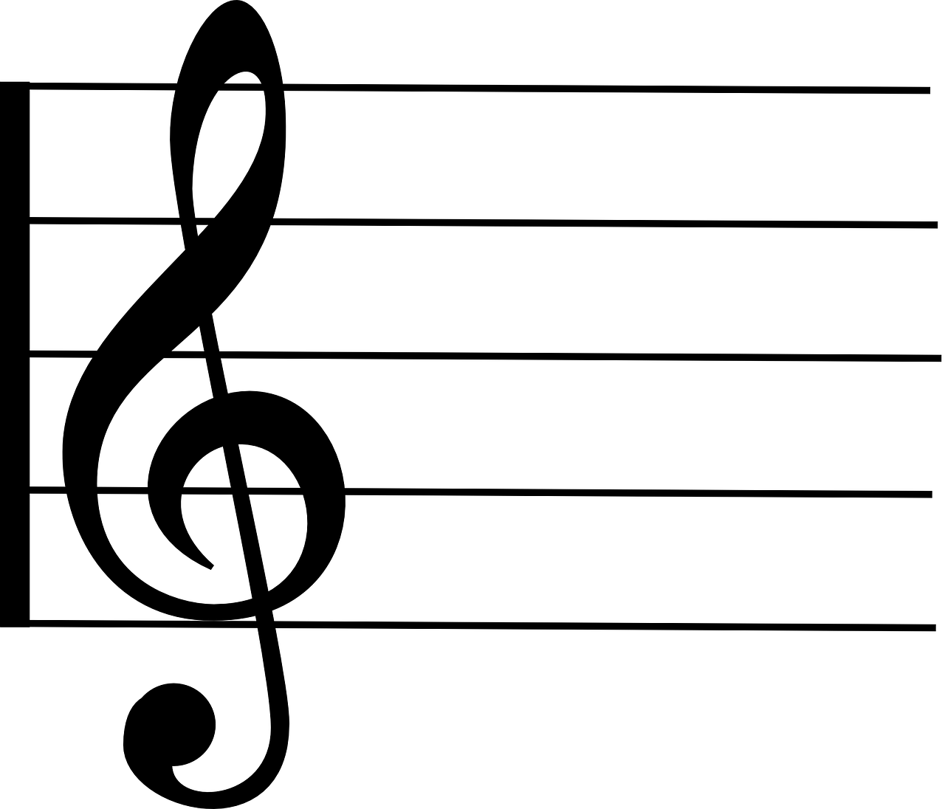
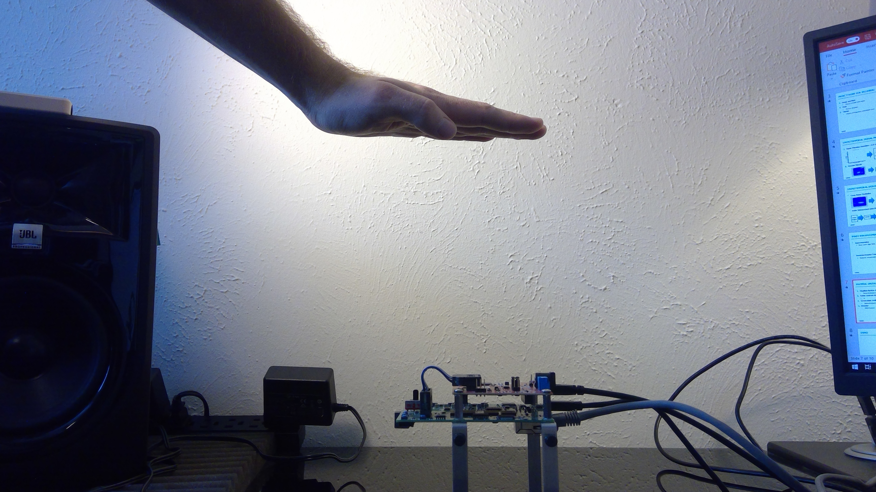

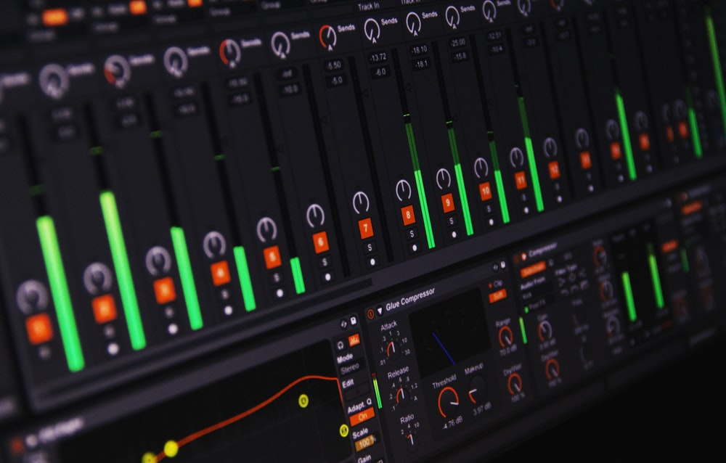
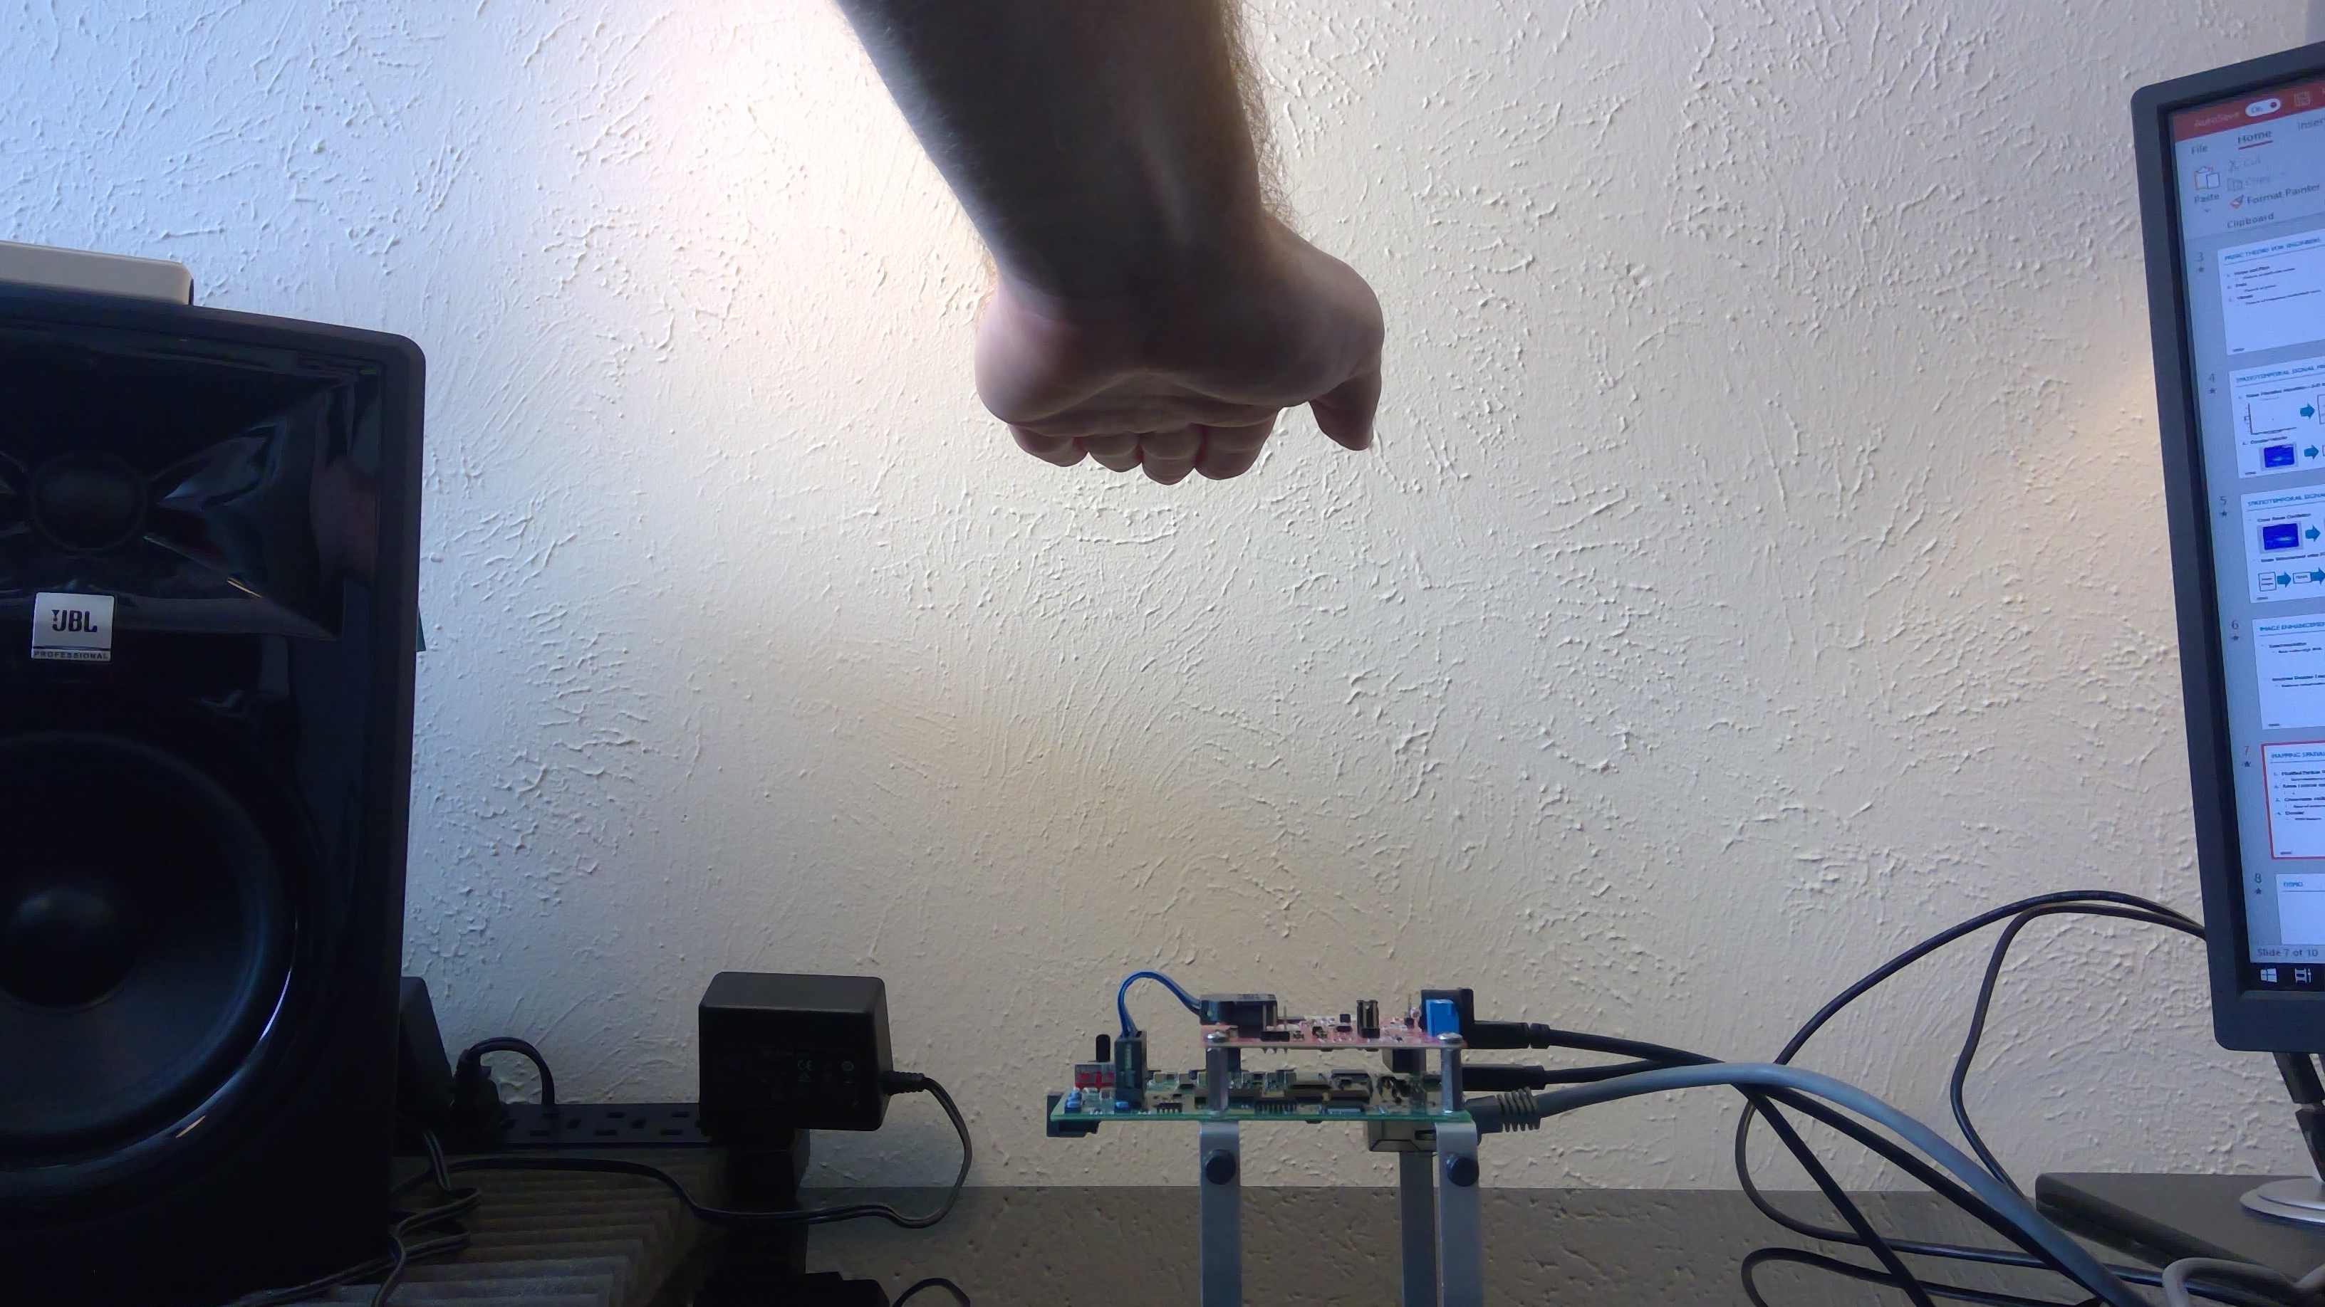
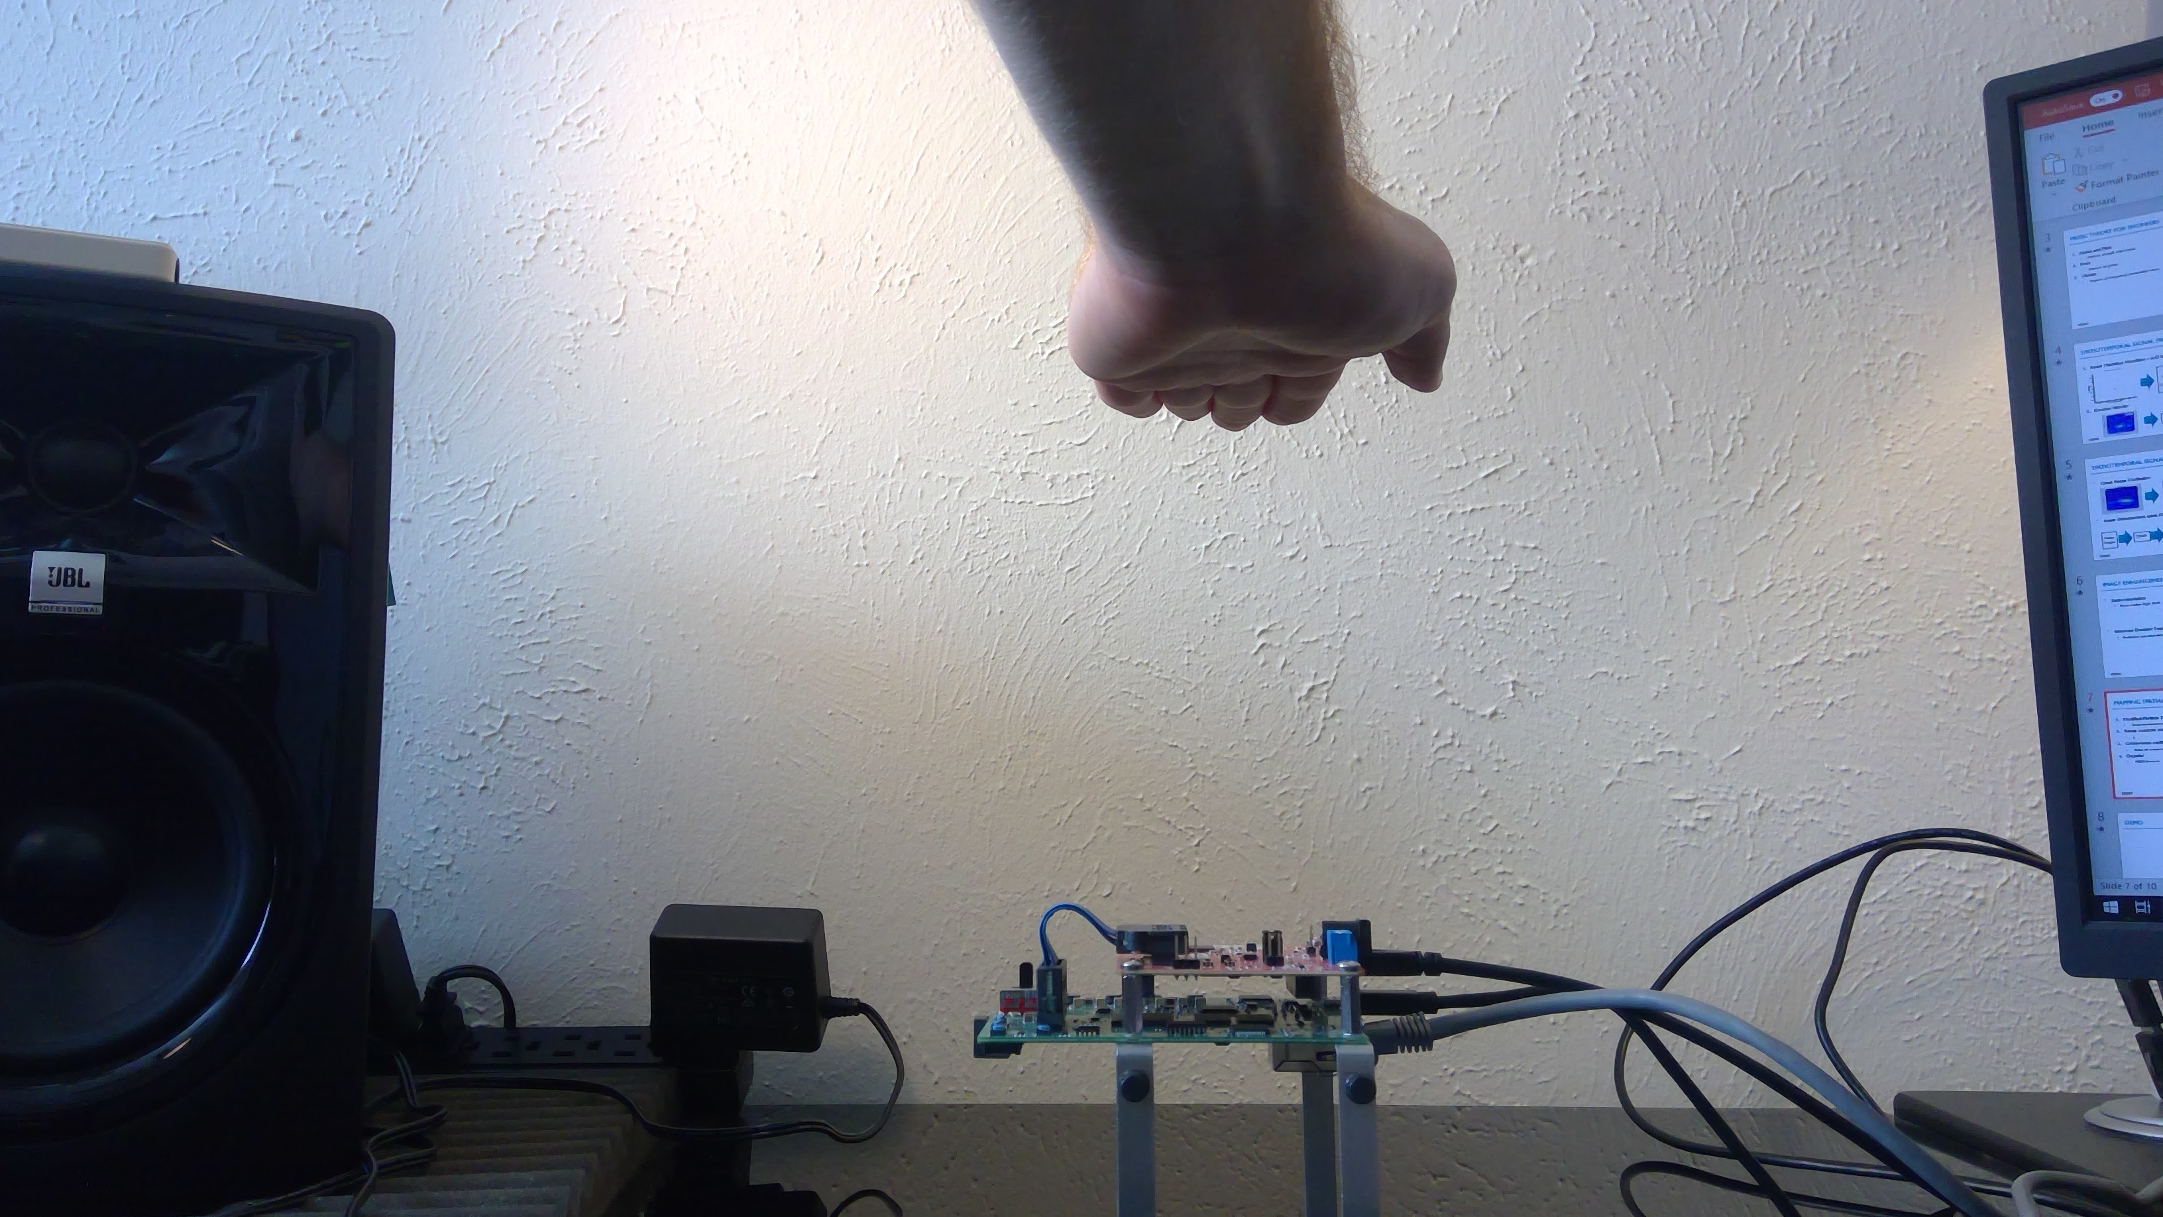
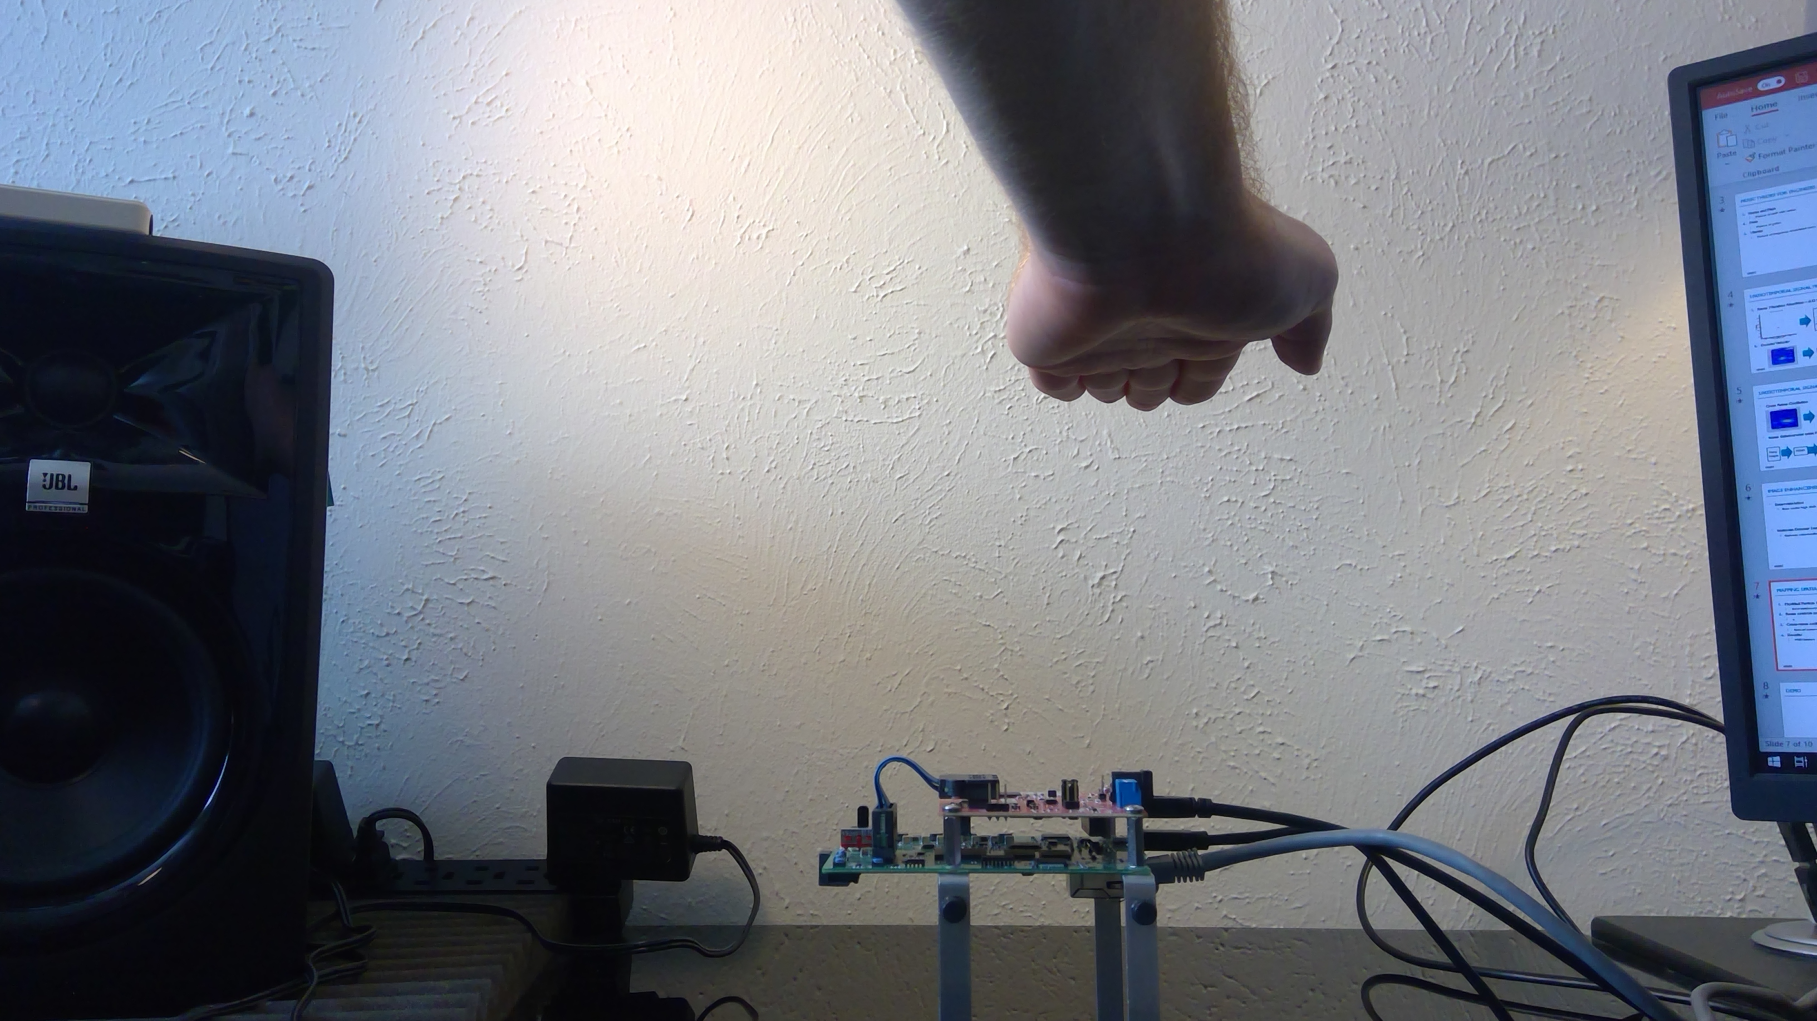
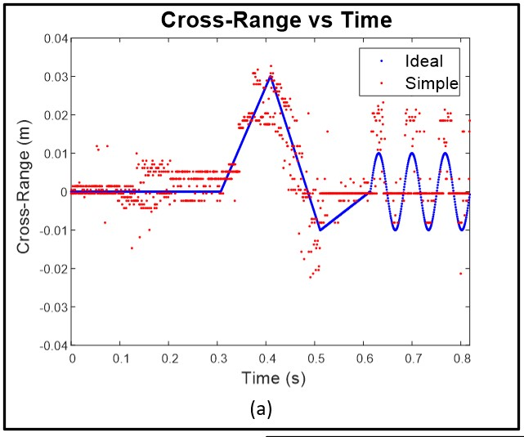
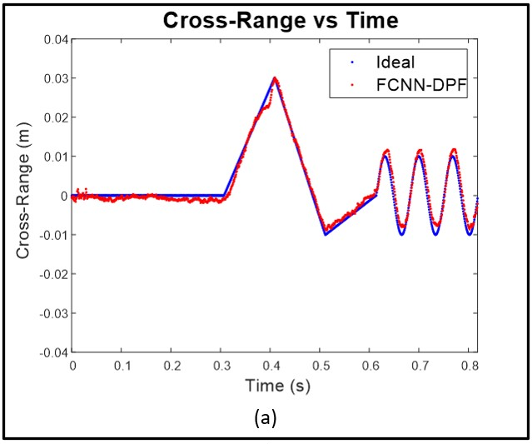

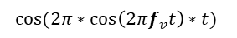
Radar Musical Instrument - A Spatiotemporal Real-Time mmWave Sensor for Contactless Human-Computer Interaction Josiah Smith, University of Texas at Dallas, TxACE
OBJECTIVE: Design non-contact musical interface using mmWave sensors and novel computer vision algorithms.
APPROACH: Develop real-time spatiotemporal signal processing chain utilizing novel machine learning and computer vision algorithms to extract spatial and temporal features of the musician’s hand from the radar beat signal.
Mapping location and movement to music
Range, cross-range oscillation rate, Doppler velocity
Super-resolution FCNN improves localization
Novel Doppler-corroborated particle filter algorithm increases tracking performance
RESULTS: High-throughput feature extraction, deep-learning enhancement, and robust tracking algorithms enable acute control of the Radar Musical Instrument and demonstrate the proficiency of mmWave technology for hand gesture tracking.
Enhancement FCNN
$$f_{v}$$
$$cos⁡(2π∗cos\left(2πf_{v}t\right)∗t)$$
Particle Filter

Slide 3
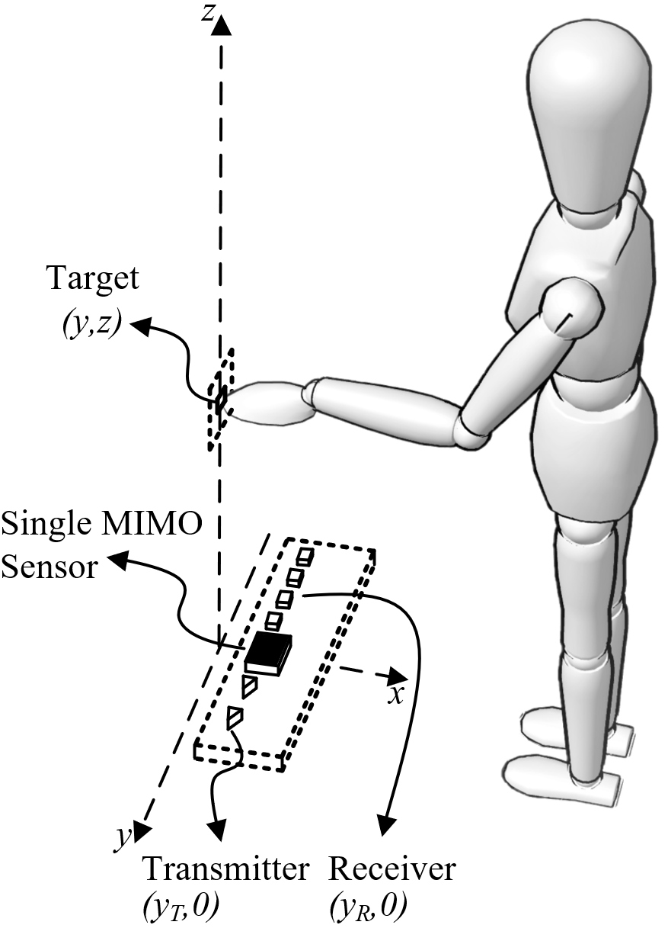

Radar Musical Instrument - A Spatiotemporal Real-Time mmWave Sensor for Contactless Human-Computer Interaction Josiah Smith, University of Texas at Dallas, TxACE
OBJECTIVE: Design non-contact musical interface using mmWave sensors and novel computer vision algorithms.
APPROACH: Develop real-time spatiotemporal signal processing chain utilizing novel machine learning and computer vision algorithms to extract spatial and temporal features of the musician’s hand from the radar beat signal.
Mapping location and movement to music
Range, cross-range oscillation rate, Doppler velocity
Super-resolution FCNN improves localization
Novel Doppler-corroborated particle filter algorithm increases tracking performance
RESULTS: High-throughput feature extraction, deep-learning enhancement, and robust tracking algorithms enable acute control of the Radar Musical Instrument and demonstrate the proficiency of mmWave technology for hand gesture tracking.

Slide 4
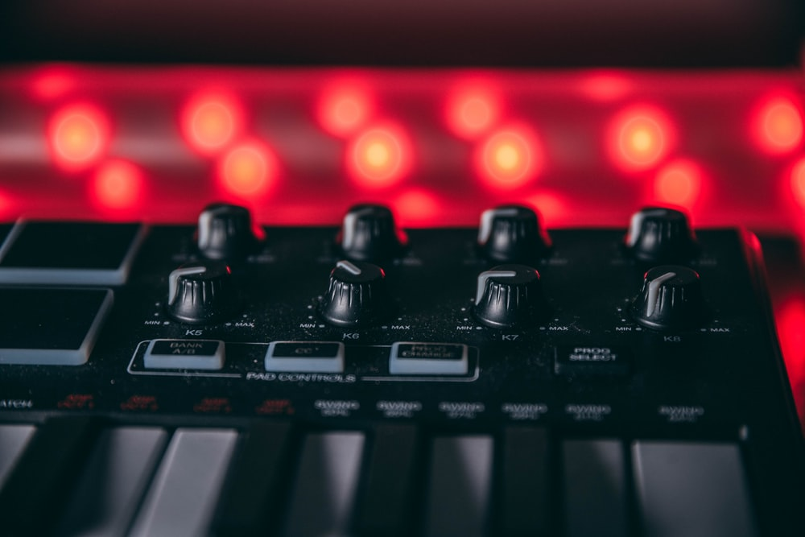

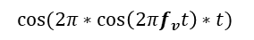
Radar Musical Instrument - A Spatiotemporal Real-Time mmWave Sensor for Contactless Human-Computer Interaction Josiah Smith, University of Texas at Dallas, TxACE
OBJECTIVE: Design non-contact musical interface using commercially available mmWave sensors.
APPROACH: Develop real-time spatiotemporal signal processing chain utilizing novel machine learning and computer vision algorithms to extract spatial and temporal features of the musician’s hand from the radar beat signal.
Mapping location and movement to music
Range, cross-range oscillation rate, Doppler velocity
Super-resolution FCNN improves localization
Novel Doppler-corroborated particle filter algorithm increases tracking performance
RESULTS: High-throughput feature extraction, deep-learning enhancement, and robust tracking algorithms enable acute control of the Radar Musical Instrument and demonstrate the proficiency of mmWave technology for hand gesture tracking.
$$f_{v}$$
$$cos⁡(2π∗cos\left(2πf_{v}t\right)∗t)$$

Slide 5
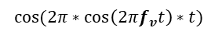
Radar Musical Instrument - A Spatiotemporal Real-Time mmWave Sensor for Contactless Human-Computer Interaction Josiah Smith, University of Texas at Dallas, TxACE
OBJECTIVE: Design non-contact musical interface using mmWave sensors and novel computer vision algorithms.
APPROACH: Develop real-time spatiotemporal signal processing chain utilizing novel machine learning and computer vision algorithms to extract spatial and temporal features of the musician’s hand from the radar beat signal.
Mapping location and movement to music
Range, cross-range oscillation rate, Doppler velocity
Super-resolution FCNN improves localization
Novel Doppler-corroborated particle filter algorithm increases tracking performance
RESULTS: High-throughput feature extraction, deep-learning enhancement, and robust tracking algorithms enable acute control of the Radar Musical Instrument and demonstrate the proficiency of mmWave technology for hand gesture tracking.
$$f_{v}$$
$$cos⁡(2π∗cos\left(2πf_{v}t\right)∗t)$$

Slide 6
Radar Musical Instrument - A Spatiotemporal Real-Time mmWave Sensor for Contactless Human-Computer Interaction Josiah Smith, University of Texas at Dallas, TxACE
OBJECTIVE: Design non-contact musical interface using mmWave sensors and novel computer vision algorithms.
APPROACH: Develop real-time spatiotemporal signal processing chain utilizing novel machine learning and computer vision algorithms to extract spatial and temporal features of the musician’s hand from the radar beat signal.
Mapping location and movement to music
Range, cross-range oscillation rate, Doppler velocity
Super-resolution FCNN improves localization
Novel Doppler-corroborated particle filter algorithm increases tracking performance
RESULTS: High-throughput feature extraction, deep-learning enhancement, and robust tracking algorithms enable acute control of the Radar Musical Instrument and demonstrate the proficiency of mmWave technology for hand gesture tracking.
$$f_{v}$$
Enhancement FCNN
$$cos⁡(2π∗cos\left(2πf_{v}t\right)∗t)$$

Slide 7
Radar Musical Instrument - A Spatiotemporal Real-Time mmWave Sensor for Contactless Human-Computer Interaction Josiah Smith, University of Texas at Dallas, TxACE
OBJECTIVE: Design non-contact musical interface using mmWave sensors and novel computer vision algorithms.
APPROACH: Develop real-time spatiotemporal signal processing chain utilizing novel machine learning and computer vision algorithms to extract spatial and temporal features of the musician’s hand from the radar beat signal.
Mapping location and movement to music
Range, cross-range oscillation rate, Doppler velocity
Super-resolution FCNN improves localization
Novel Doppler-corroborated particle filter algorithm increases tracking performance
RESULTS: High-throughput feature extraction, deep-learning enhancement, and robust tracking algorithms enable acute control of the Radar Musical Instrument and demonstrate the proficiency of mmWave technology for hand gesture tracking.
Enhancement FCNN
$$f_{v}$$
$$cos⁡(2π∗cos\left(2πf_{v}t\right)∗t)$$
Particle Filter

Slide 8
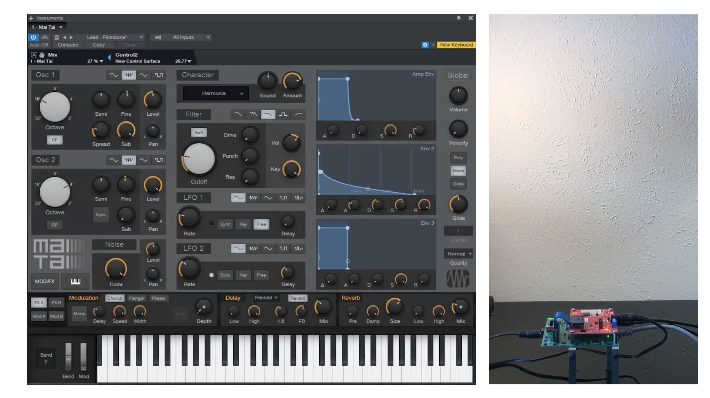
Radar Musical Instrument - A Spatiotemporal Real-Time mmWave Sensor for Contactless Human-Computer Interaction Josiah Smith, University of Texas at Dallas, TxACE
OBJECTIVE: Design non-contact musical interface using mmWave sensors and novel computer vision algorithms.
APPROACH: Develop real-time spatiotemporal signal processing chain utilizing novel machine learning and computer vision algorithms to extract spatial and temporal features of the musician’s hand from the radar beat signal.
Mapping location and movement to music
Range, cross-range oscillation rate, Doppler velocity
Super-resolution FCNN improves localization
Novel Doppler-corroborated particle filter algorithm increases tracking performance
RESULTS: High-throughput feature extraction, deep-learning enhancement, and robust tracking algorithms enable acute control of the Radar Musical Instrument and demonstrate the proficiency of mmWave technology for hand gesture tracking.
Enhancement FCNN
$$f_{v}$$
$$cos⁡(2π∗cos\left(2πf_{v}t\right)∗t)$$
Particle Filter

Slide 9
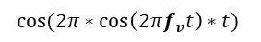
Radar Musical Instrument - A Spatiotemporal Real-Time mmWave Sensor for Contactless Human-Computer Interaction Josiah Smith, University of Texas at Dallas, TxACE
OBJECTIVE: Design non-contact musical interface using mmWave sensors and novel computer vision algorithms.
APPROACH: Develop real-time spatiotemporal signal processing chain utilizing novel machine learning and computer vision algorithms to extract spatial and temporal features of the musician’s hand from the radar beat signal.
Mapping location and movement to music
Range, cross-range oscillation rate, Doppler velocity
Super-resolution FCNN improves localization
Novel Doppler-corroborated particle filter algorithm increases tracking performance
RESULTS: High-throughput feature extraction, deep-learning enhancement, and robust tracking algorithms enable acute control of the Radar Musical Instrument and demonstrate the proficiency of mmWave technology for hand gesture tracking.
$$f_{v}$$
$$cos⁡(2π∗cos\left(2πf_{v}t\right)∗t)$$
Enhancement FCNN
Particle Filter

Slide 10
Radar Musical Instrument - A Spatiotemporal Real-Time mmWave Sensor for Contactless Human-Computer Interaction Josiah Smith, University of Texas at Dallas, TxACE
OBJECTIVE: Design non-contact musical interface using mmWave sensors and novel computer vision algorithms.
APPROACH: Develop real-time spatiotemporal signal processing chain utilizing novel machine learning and computer vision algorithms to extract spatial and temporal features of the musician’s hand from the radar beat signal.
Mapping location and movement to music
Range, cross-range oscillation rate, Doppler velocity
Super-resolution FCNN improves localization
Novel Doppler-corroborated particle filter algorithm increases tracking performance
RESULTS: High-throughput feature extraction, deep-learning enhancement, and robust tracking algorithms enable acute control of the Radar Musical Instrument and demonstrate the proficiency of mmWave technology for hand gesture tracking.
Enhancement FCNN
$$f_{v}$$
$$cos⁡(2π∗cos\left(2πf_{v}t\right)∗t)$$
Particle Filter

